Slide 1

Machine Learning Methods for Satellite Image Analysis: Neural Networks and Support Vector Machines Macarena Ortiz & Juan Pinales November 18, 2015 Lunchbytes

Slide 2
Support Vector Machines - Background
The foundations of SVM have been developed by Vapnik (1995), Burges (1998) and Smola (et al,. 1998).
Gaining popularity due to attractive features and empirical performance.
Goal is to produce a classifier that will work well on unseen examples, i.e it generalizes well.
Can do classification and regression
Makes use of Structural Risk Minimization (minimizing risk function)

Slide 3
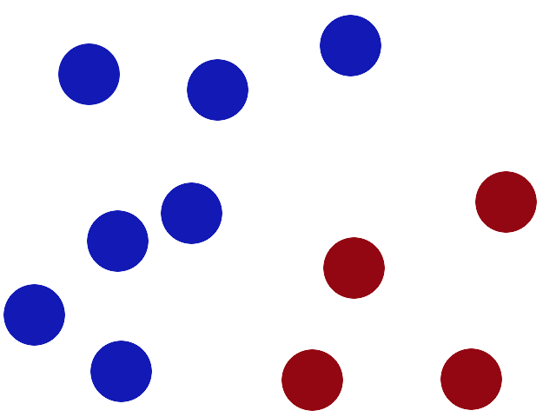
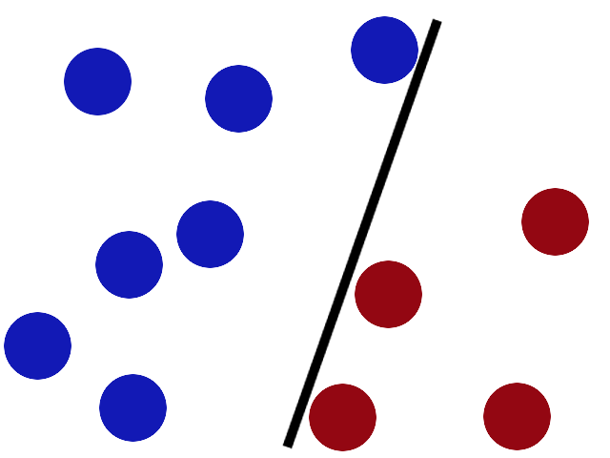
Support Vector Machines - Introduction
Want to separate 2 colors of balls on a table
Get stick and put between balls…EASY!

Slide 4
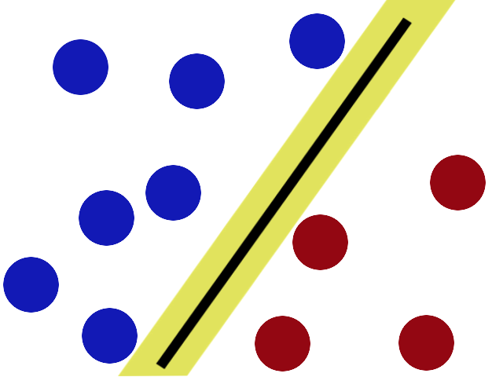
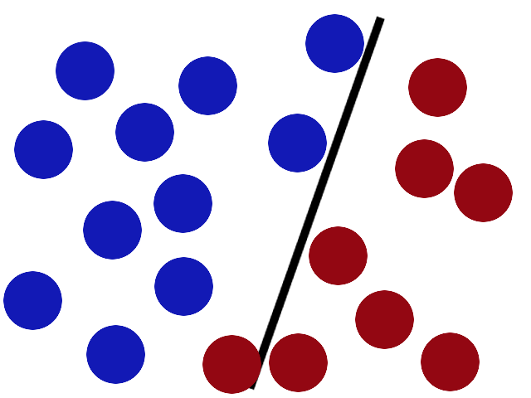
Support Vector Machines - Introduction
Someone puts more balls on the table now…stick needs better placement ☹
SVMs try to put the “stick” (hyperplane) in the best possible place by having the greatest gap (margin) possible on either side of the stick as it can

Slide 5

Support Vector Machines - Introduction
Hyperplane:
in one dimension, an hyperplane is called a point
in two dimensions, it is a line
in three dimensions, it is a plane
in more dimensions you can call it an hyperplane
Margin:
Once you found a hyperplane, compute distance between hyperplane and closest data point → double it, then you got a margin!

Slide 6
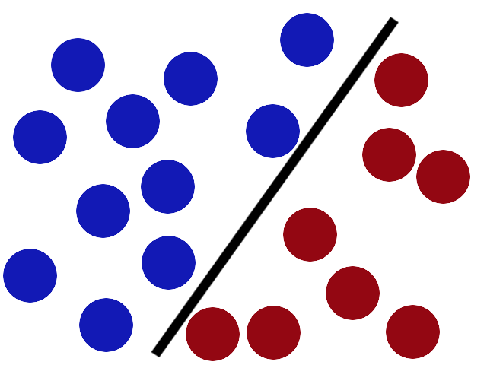
Support Vector Machines - Introduction
SVM

Slide 7

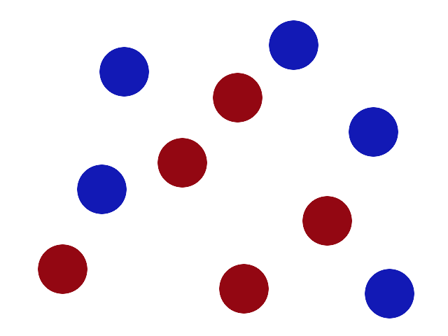
Support Vector Machines - Introduction

Slide 8

Support Vector Machines - Introduction
Flip the table, throw balls into the air and grab a sheet of paper and slip it between the balls!!

Slide 9
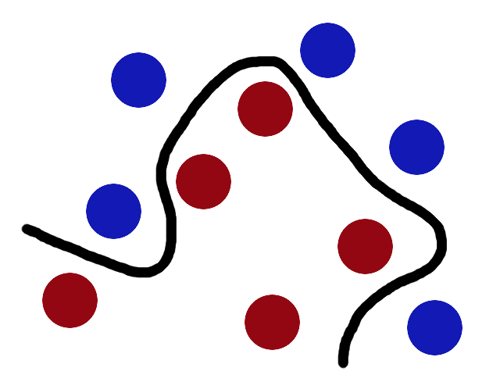
Support Vector Machines - Introduction
SVM
The goal of a support vector machine is to find the optimal separating hyperplane which maximizes the margin of the training data.

Slide 10
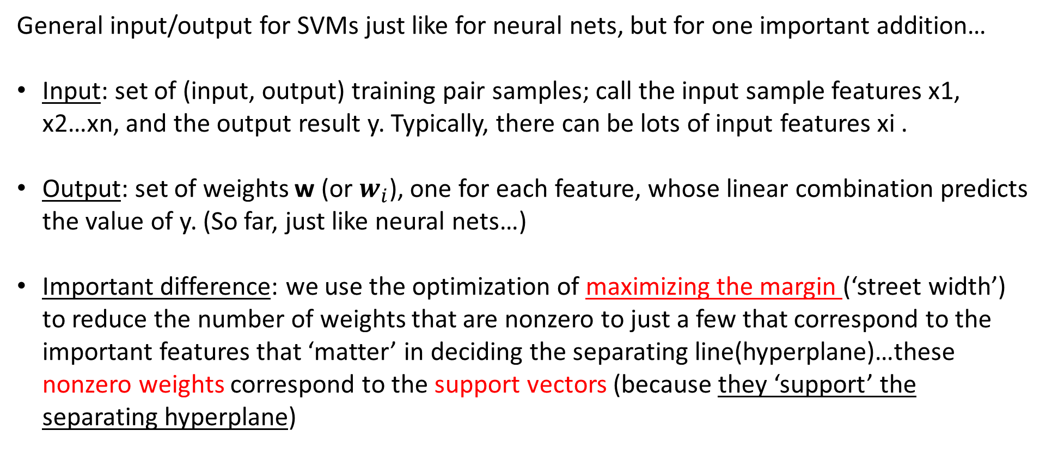
Support Vector Machines - Introduction
General input/output for SVMs just like for neural nets, but for one important addition…
Input: set of (input, output) training pair samples; call the input sample features x1, x2…xn, and the output result y. Typically, there can be lots of input features xi .
Output: set of weights w (or $w_{i}$), one for each feature, whose linear combination predicts the value of y. (So far, just like neural nets…)
Important difference: we use the optimization of maximizing the margin (‘street width’) to reduce the number of weights that are nonzero to just a few that correspond to the important features that ‘matter’ in deciding the separating line(hyperplane)…these nonzero weights correspond to the support vectors (because they ‘support’ the separating hyperplane)
http://web.mit.edu/6.034/wwwbob/svm-notes-long-08.pdf

Slide 11
Support Vector Machines – SVMs v.s Neural Networks
Relatively new concept
Deterministic algorithm
Nice Generalization properties
Using kernels can learn very complex functions
Faster and lower computational cost for small data sets
Great for global minima
Support “Bros”
Relatively old
Nondeterministic algorithm
Generalizes well but doesn’t have strong mathematical foundation
To learn complex function – use multilayer perceptron
Greater computational cost (if adding more neurons or hidden layers) even in small data sets
Great for local Minima
Better for multi-class learning?

Slide 12
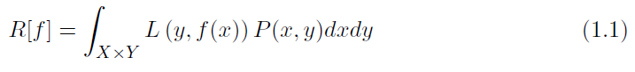
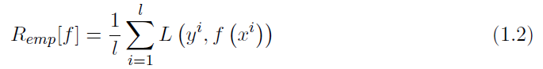
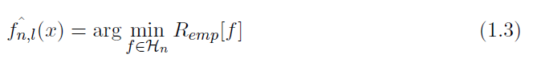
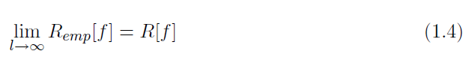
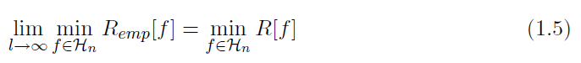
Support Vector Machines – SRM principle (Because, Math)
Expected value of the loss, but we don’t know P :(
Approx real life loss
Function of minimum real life loss in hypothesis space
Means it doesn’t diverge (a.k.a go crazy)
For a particular function in hypothesis space, min f is what we are looking for

Slide 13
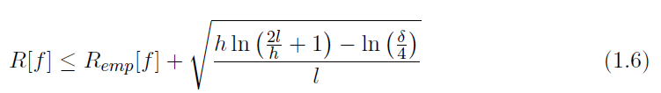
Support Vector Machines – SRM principle (Math Stuff)
Empirical risk function
But Vapnik (1995) introduces something called a VC dimension…….
A measure of the largest set of points that the algorithm can shatter

Slide 14
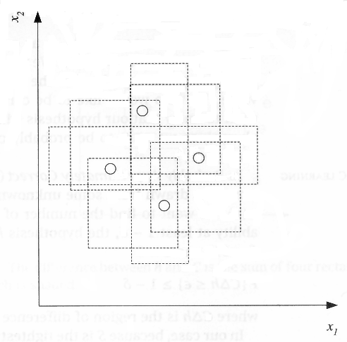
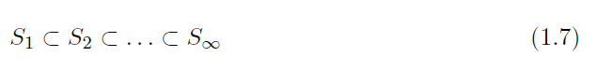
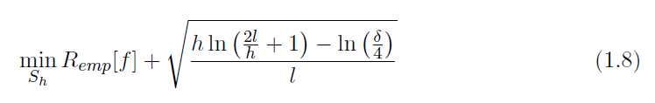
Support Vector Machines – SRM principle (Math Stuff)
Create a structure such that $S_{h}$is a hypothesis space of VC dimension h then,
VC Measures the capacity of the hypothesis class
Example of a hypothesis class

Slide 15
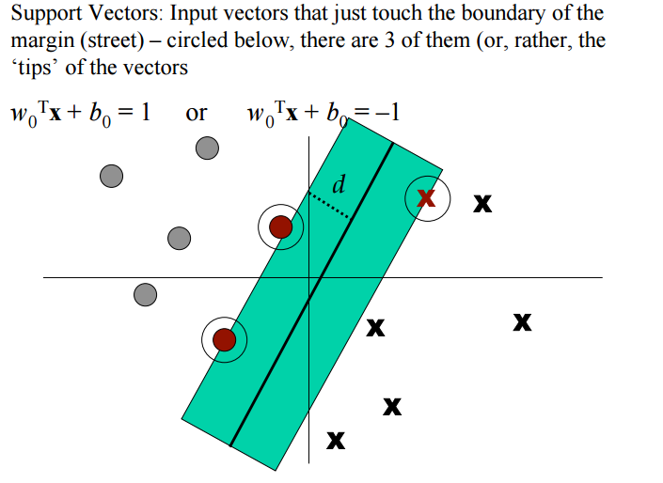
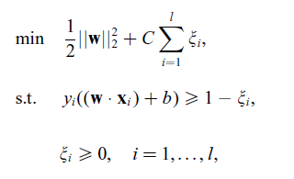
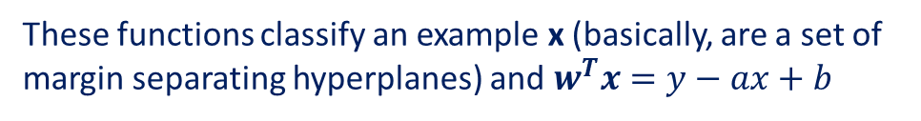
Support Vector Machines – Because, Math
Support “Bros”
SVMs for pattern recognition have the following optimization problem:
Plays the role of controlling the capacity of the learning machine (x is the weight vector)
Empirical risk
These functions classify an example x (basically, are a set of margin separating hyperplanes) and $w^{T}x=y−ax+b$

Slide 16

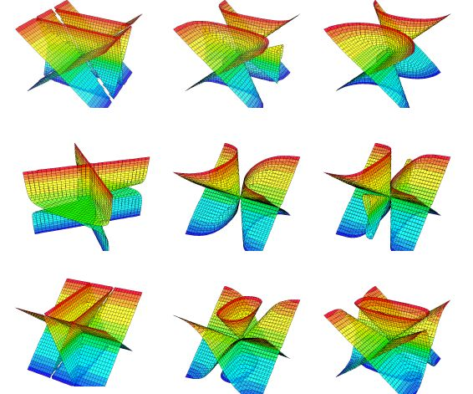
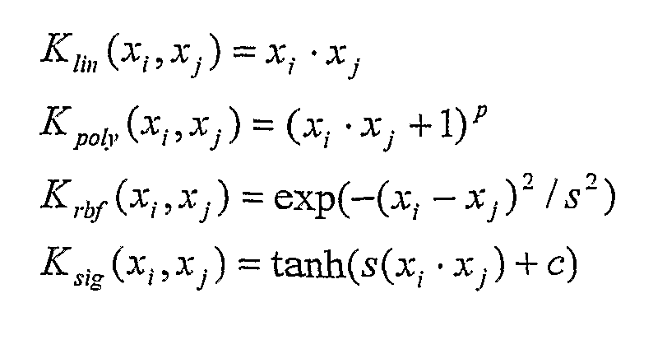
Support Vector Machines-Basics of What You Need
“Data”
(vectors)
“Classifier”
(help from Support Bros)
“Flipping Table”
(Kernel Function)
“Hyperplane”

Slide 17
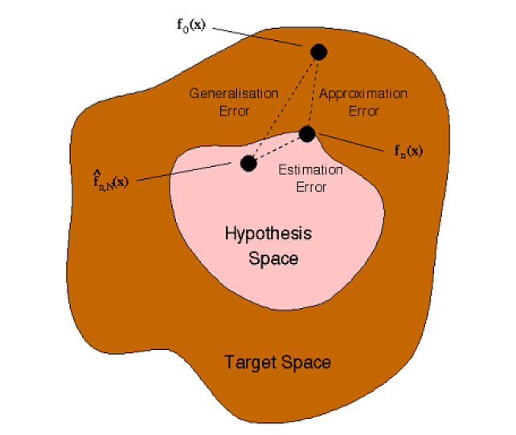
Support Vector Machines – Math Stuff
Statistical Learning theory: Learning from examples
Approximation error – when hypothesis space is smaller than the target space → underlying function may lie outside the hypothesis space. Results in large approximation error
Estimation error – error due to the learning procedure which results in a technique selecting the non-optimal model from the hypothesis space.
In SVMs we are minimizing the approximation error & estimation error, which leads to a generalization error in n dimensions, exploiting dimensions of the hypothesis space.

Slide 18
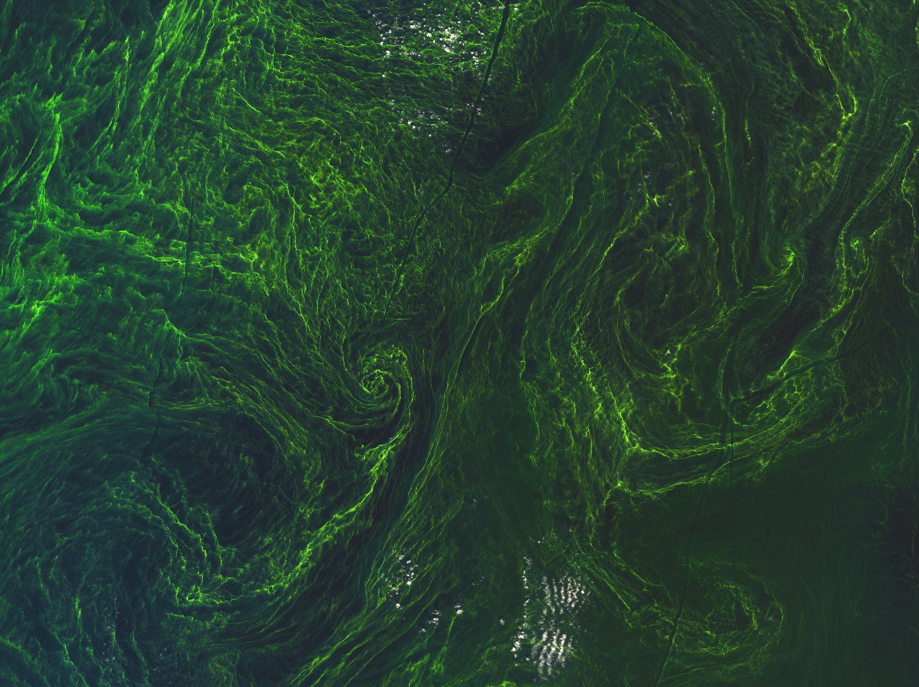
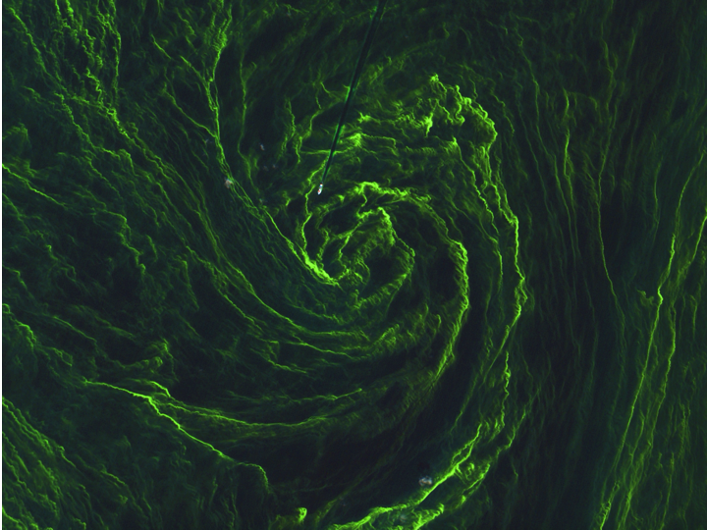
Support Vector Machines – Real Life Example! Step 1, Choose Training Image
Satellite image of Algal bloom over ocean
Sub-box image to use for training
Sentinel-2A (Multispectral Imager)

Slide 19
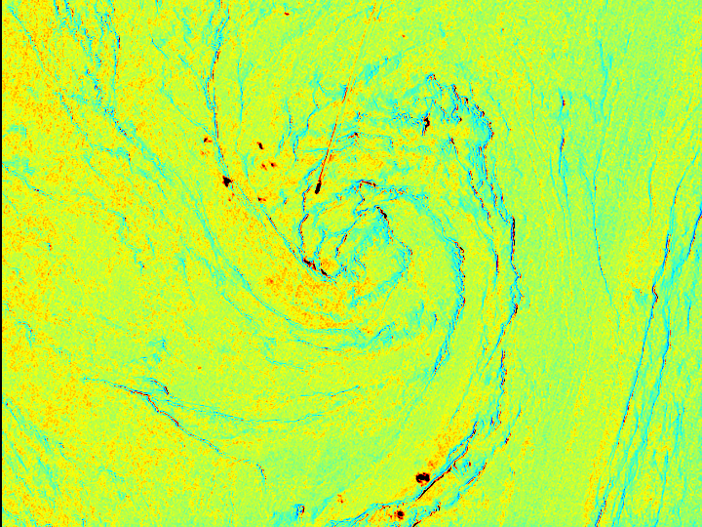
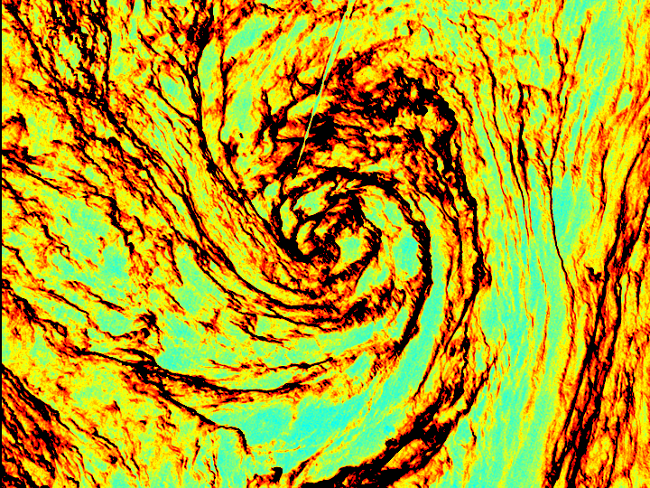
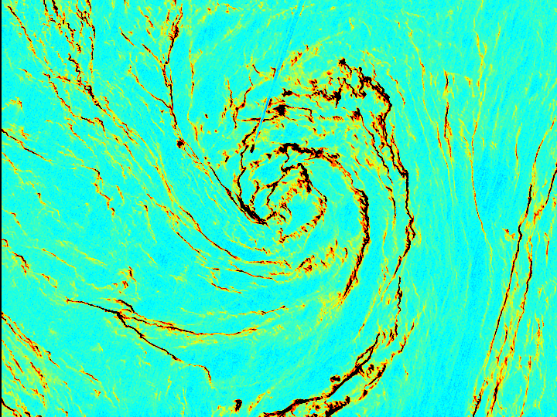
Support Vector Machines – Real Life Example! Step 2, Choose Training Image
Attributes
has
Blue
Green
Red
Image bands
Sentinel-2A (Multispectral Imager)
Notes:
Sentinel-2A captured this detailed image of an algal bloom in the middle of the Baltic Sea on 7 August 2015. The image, which has a spatial resolution of 10 m, reveals the bloom in exquisite detail as well as a ship heading into the ‘eye of this algal storm’. The ship’s wake can be seen as a straight dark line where the bloom has been disturbed by the ship’s propellers.

Slide 20
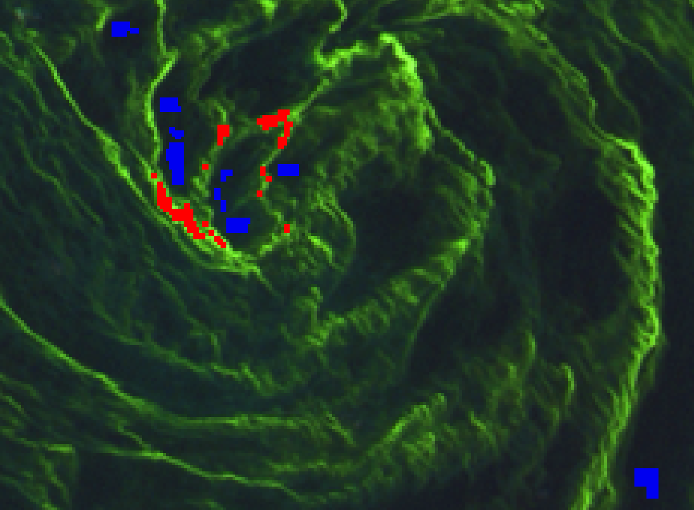
Support Vector Machines – Real Life Example! Step 3, Choose Training Image Targets
Training Data: Blue = water , Red = algae

Slide 21
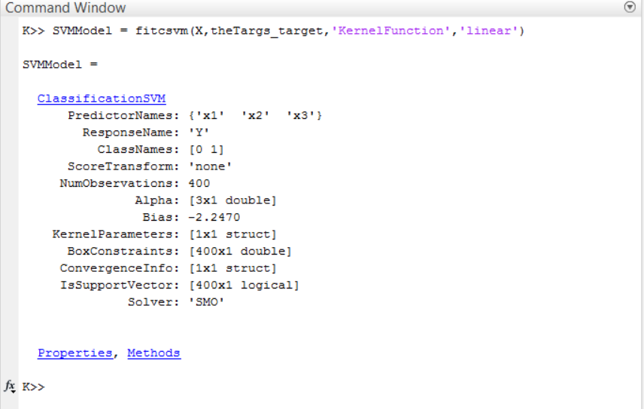
Support Vector Machines – Real Life Example! Step 4, Format Data To Fit SVM Function in Matlab Toolbox
Vectorized Image Data
“X”
+
Vectorized Image Targets
Blue = water ,
Red = algae
27, 28, 26, …
Red band
47, 50, 49, …
Green band
Apply fitcsvm function
40, 38, 37, …
Blue band

Slide 22
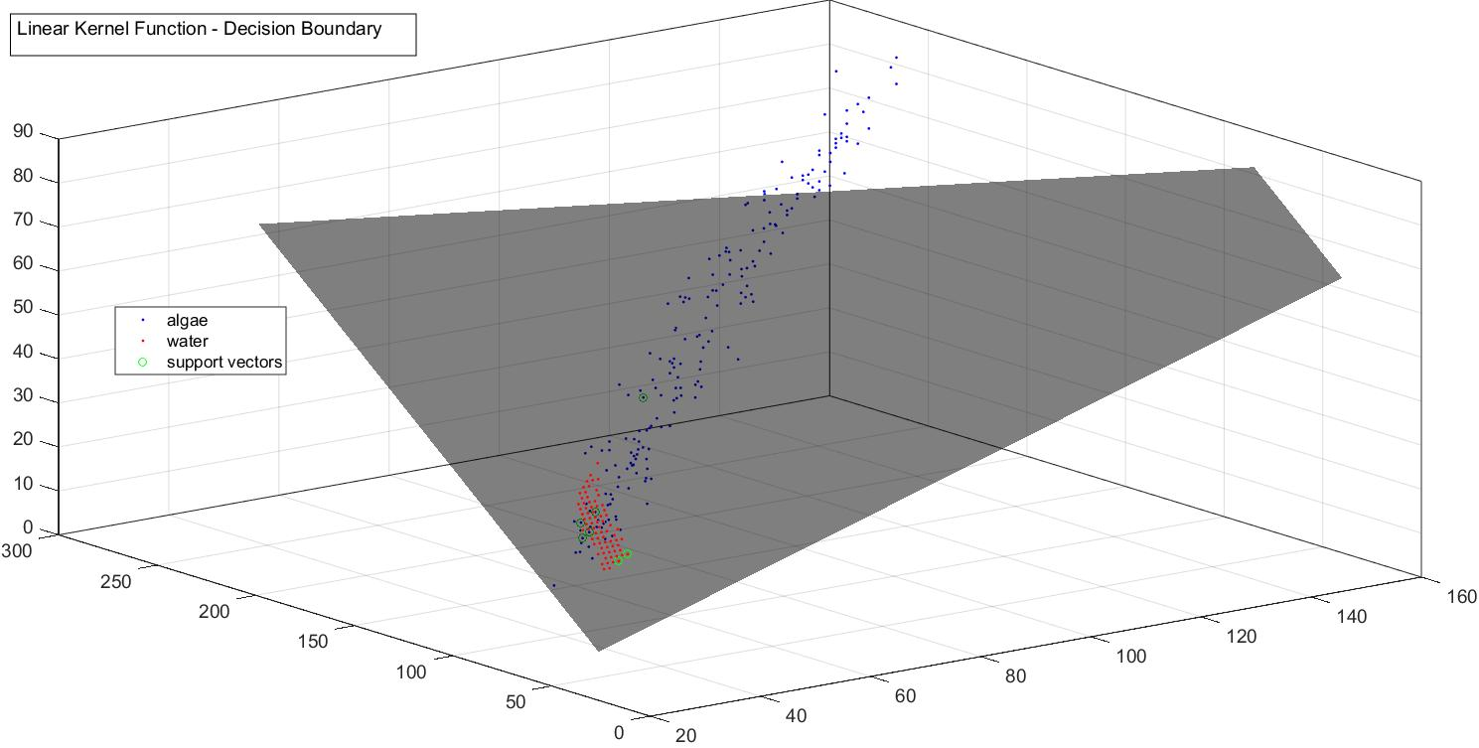
Algae Support Bros
Water
Support Bros
Support vectors are :
Data points that lie closest to the decision surface (or hyperplane)
Are the data points most difficult data to classify
Have direct bearing on the optimum location of the decision surface

Slide 23

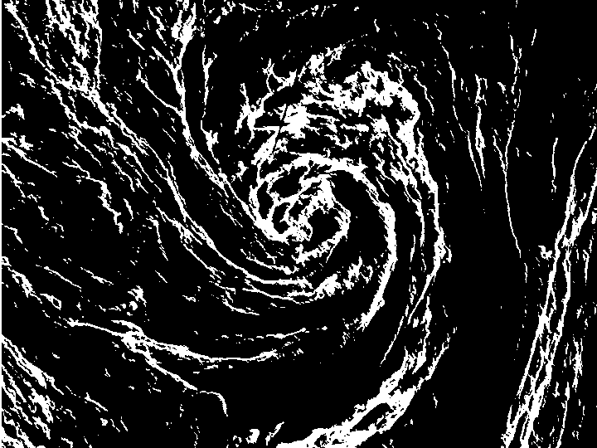
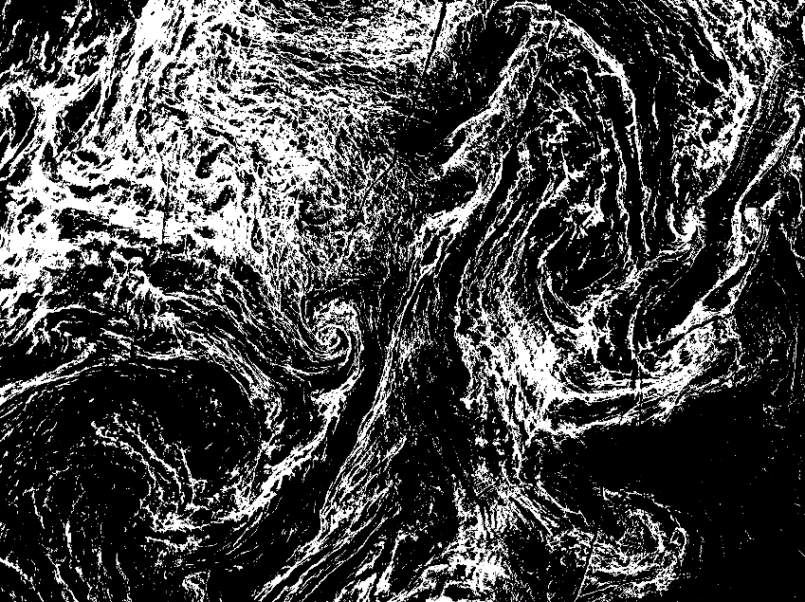
Support Vector Machines – Real Life Example! Classify Image With Model

Slide 24
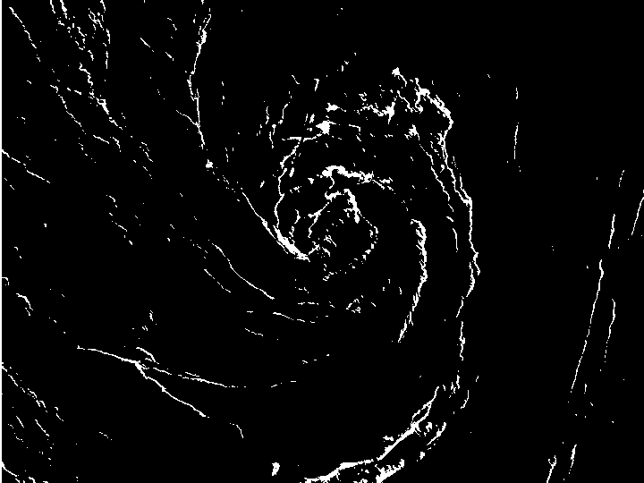
SVM Compared To Simple Thresholding
SVM Classified Image
Automatic Binary Threshold Image

Slide 25
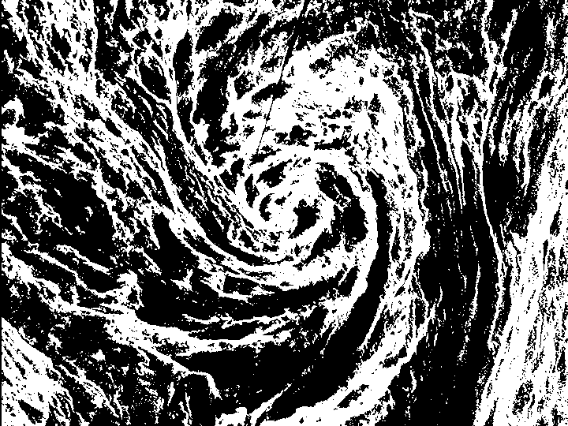
SVM and Neural Network Classified Image
SVM Classified Image
NN Classified Image

Slide 26
Support Vector Machines – Worthy To Mention, But Not Included Here
Box constraint to reduce the # of support vectors
Standardizing data (if it fallows a normal distribution)
Cross validate SVM classifier (a standard technique for adjusting hyperparameters of predictive models)
Detect outliers in your SVM
Find multiple class boundaries
Cache size
Categorical predictors
Misclassification cost
Gap tolerance
Receiver operating characteristic (ROC) curve or other performance curve for classifier output
List goes on…..

Slide 27
SVM Toolboxes and Reseources
http://www.mathworks.com/help/stats/support-vector-machine-classification.html
http://research.cs.wisc.edu/dmi/svm/content.html
http://www.support-vector-machines.org/SVM_soft.html
https://www.csie.ntu.edu.tw/~cjlin/libsvm/
Python, R, MATLAB, Perl, Ruby, Weka, Common LISP, CLISP, Haskell, OCaml, LabVIEW, and PHP interfaces. C# .NET code and CUDA extension is available. It's also included in some data mining environments: RapidMiner, PCP, and LIONsolver.

